Slide 1
Pre-evaluation system
Dongmin Kim
Associate Professor of Internal Medicine
College of Medicine, Dankook University
2022.10.21
Notes:
Thank you for having me.
It’s honor to stand here.
Today, I will talk about AF and cognitive function focused on rhythm control.

Slide 2
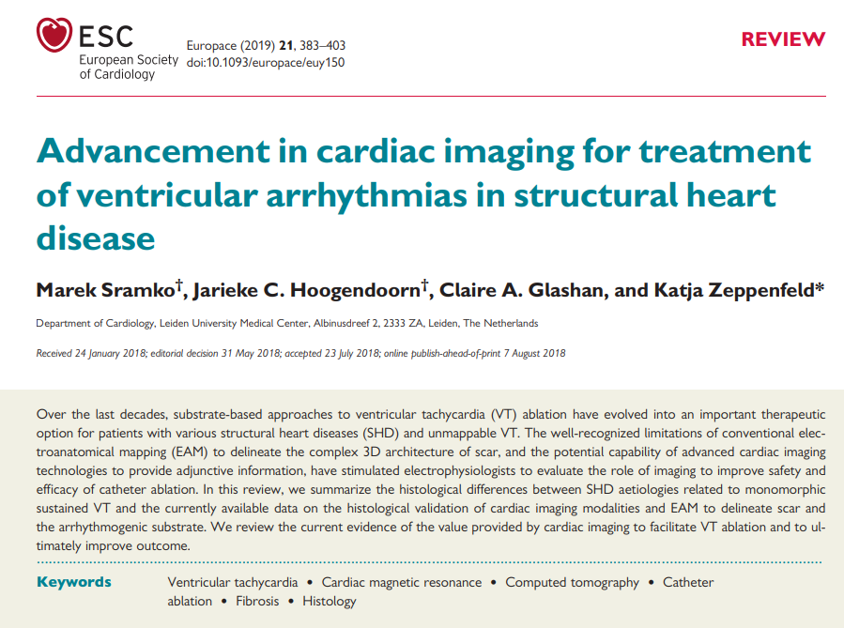
otential changes that may occur between the image acquisition and ablation

Slide 3
Pre-procedural evaluation of scar
Substrate-based approaches to VT ablation
Esp. in patients with various structural heart diseases
Unmappable VT
Conventional electroanatomical mapping (EAM)
limitations to delineate the complex 3D architecture of scar
Advanced cardiac imaging technologies

Slide 4
Cardiac imaging to delineate scar
Late gadolinium-enhanced (LGE)-CMR
preferred imaging technique to delineate scar
Computed tomography
has a significantly higher spatial resolution
the unfavourable signal-to-noise ratio with suboptimal results, particularly for chronic scars
iodine-based contrast agents
PET and SPECT
can distinguish non-viable scar, viable hibernating scar, and healthy myocardium
a poor resolution.
Intracardiac echocardiography
has been used to delineate scar based on wall-thinning, wall motion abnormalities
occasionally the heterogeneity in SI

Slide 5
Electroanatomical voltage mapping to delineate scar
EAVM: the gold standard in electrophysiology for invasive scar identification
Areas of low bipolar voltages (BV) <1.5 mV recorded with large tip electrodes (3.5–4.0 mm) are usually considered scar
Bipolar electrogram amplitudes depend on
electrode size and spacing
orientation of the catheter
wavefront propagation

Slide 6
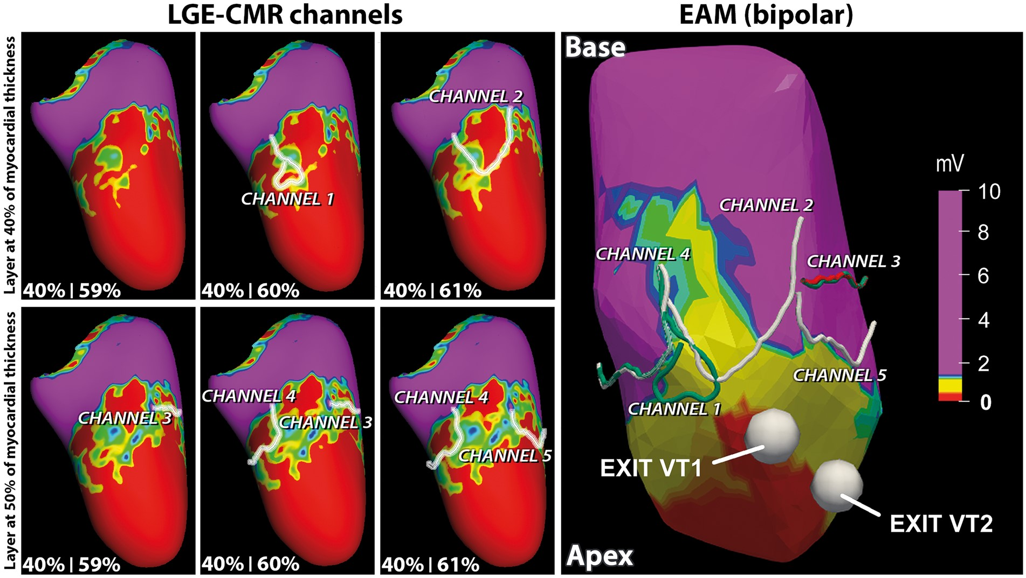

Slide 7
Pre-procedural imaging
TTE
evaluate cardiac and valvular function
exclude mobile intracavitary thrombi
LGE-CMR and PET-CT
underlying aetiology and disease activity
location and pattern of scar
first-line endo-epicardial approach
prevent unnecessary epicardial access
a retrograde vs transseptal approach

Slide 8
Impact of cardiac imaging on outcome of ablation

Slide 9
Real-time integration
Focus high-resolution EAM on scar areas
Visualization of scar: identify VT substrate in regions with ‘normal’ voltage or reveal falsely low voltage due to poor catheter contact
Visualization of epicardial fat
Visualize the coronary arteries and the course of the left-sided phrenic nerve

Slide 10
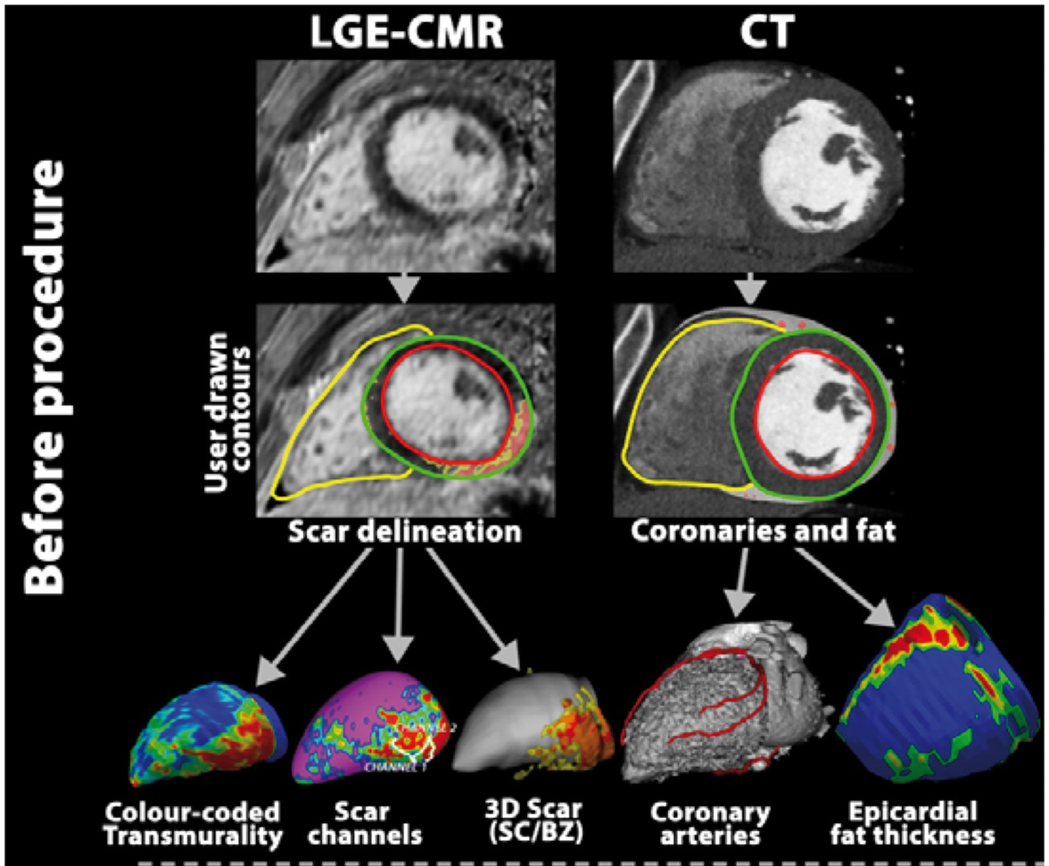

Slide 11
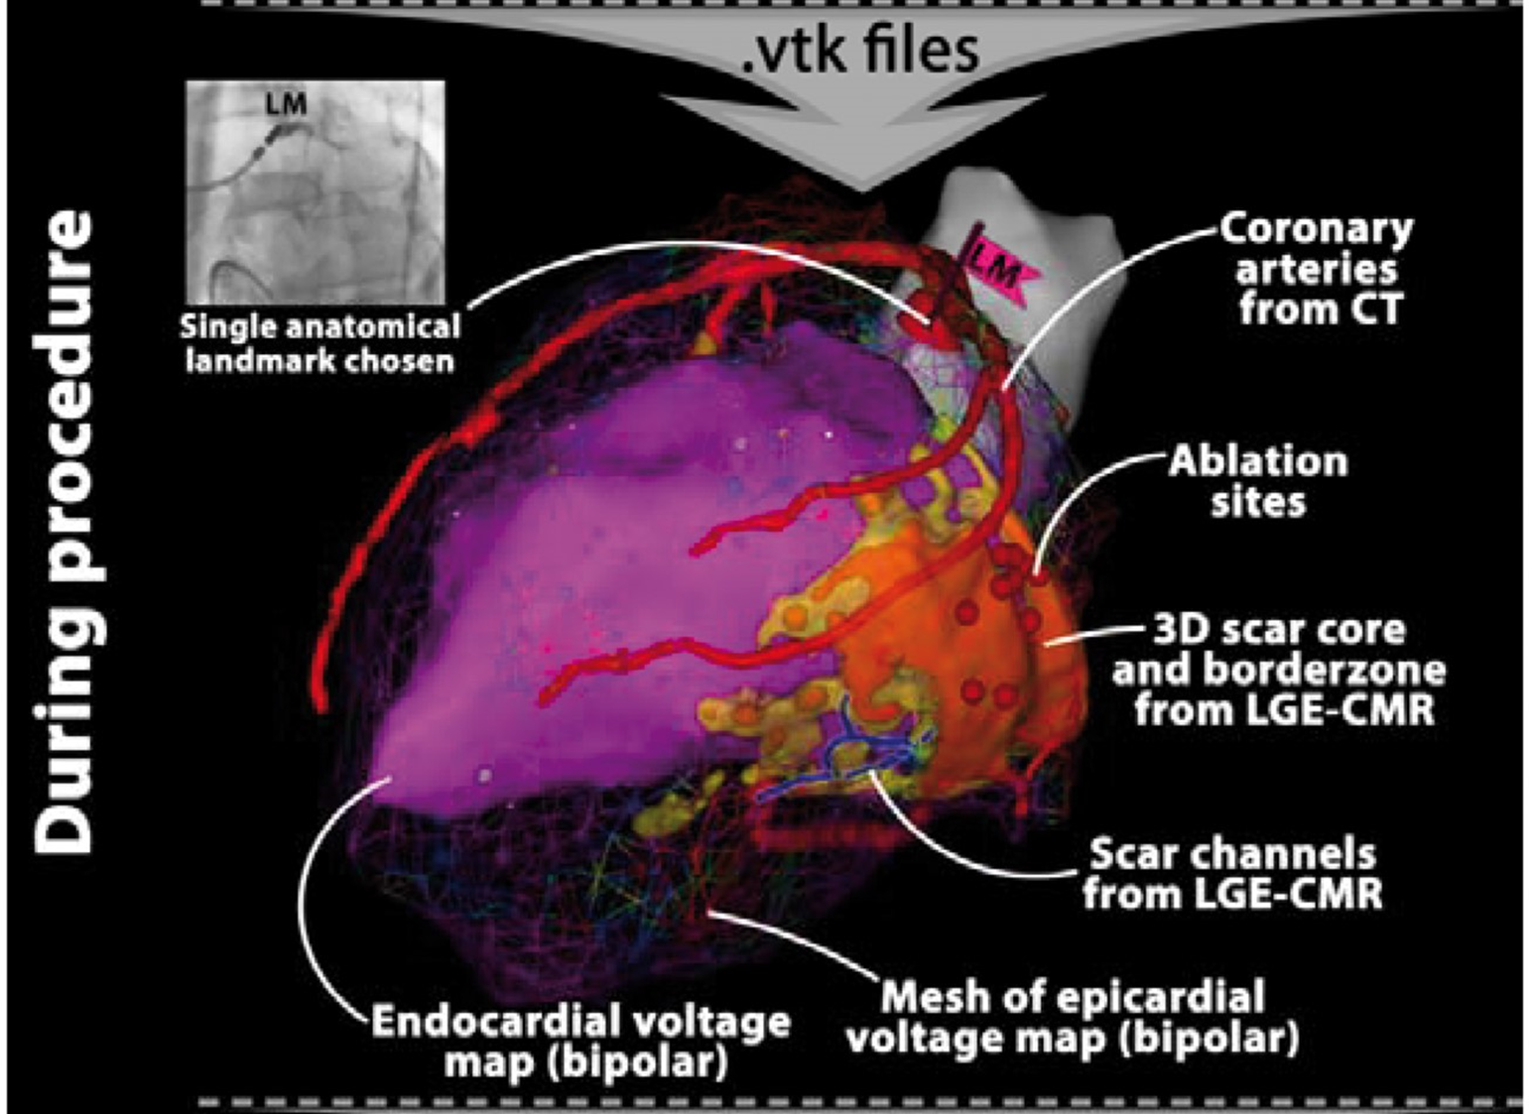

Slide 12
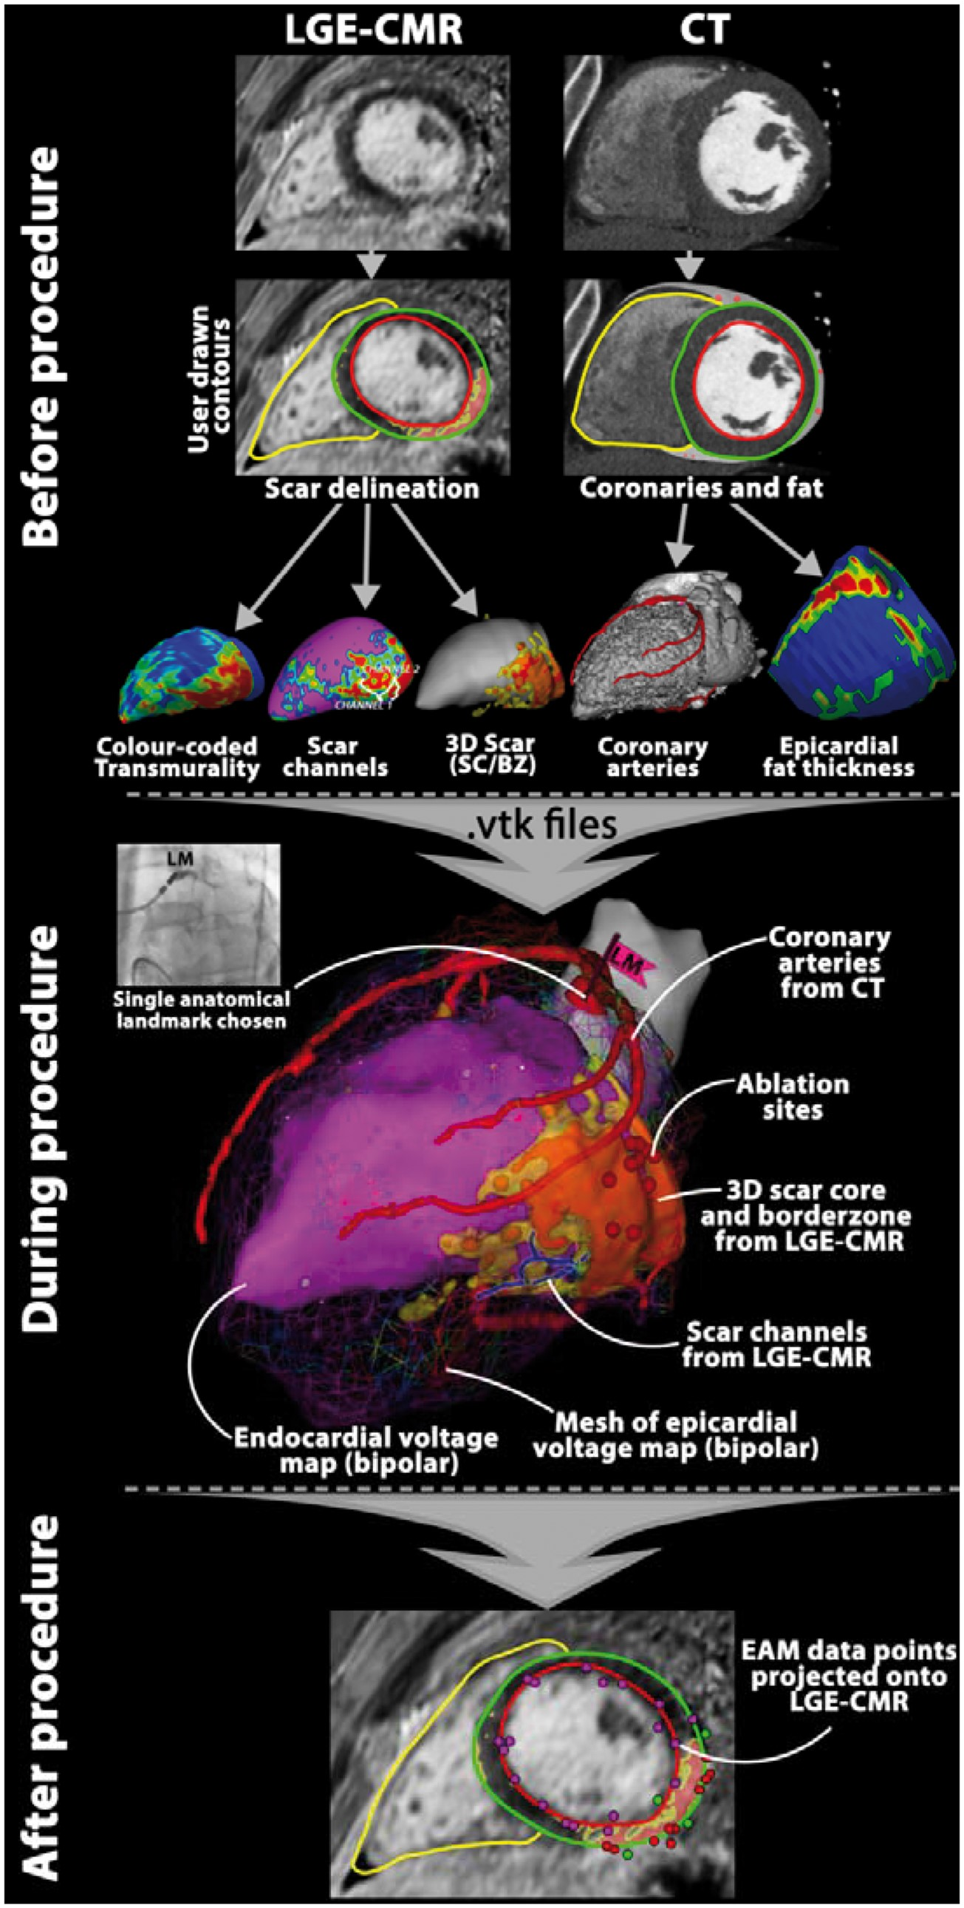

Slide 14
In summary
Identification of arrhythmogenic substrate
Procedural planning
May impact outcomes of ablation
Limitations
The lack of a universality
A need for standardization of definitions of tissue characteristics
The limitations of performing CMR in patients with ICD
Potential changes that may occur between the image acquisition and ablation

Slide 15
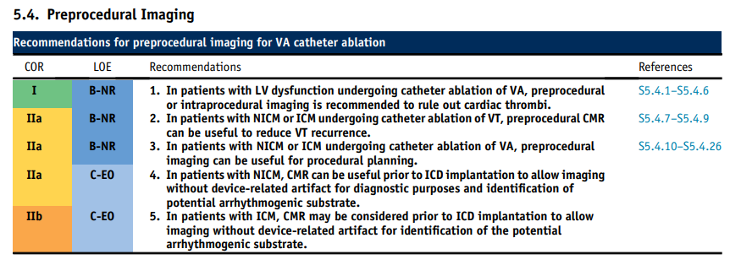
2019 HRS/EHRA/APHRS/LAHRS expert consensus statement on catheter ablation of ventricular arrhythmias

Slide 16
Thank you for your attention

